Slide 1
NORTHEASTERN UNIVERSITY
College of Engineering
INFO5100 Application Engineering and Development
Final Project Presentation - Event Sigma LLC - Event Management System
Aditya Prakash (002724514)
Divyesh Rajput (002788618)
Shashank Dongre (002747740)

Slide 2
Introduction
Existing Event Management Systems are niche and domain specific
This leads to inefficient resource allocation in planning and scheduling a collaborative event
The application's major goal is to provide a common platform for several end users
Event Sigma LLC aims at the integration of multi-party enterprises
The application features Email notifications and QR code generation which are used for updates/status tracking and ticket booking
Lastly, this application can also function as an aggregator of individual event-hosting platforms.

Slide 3
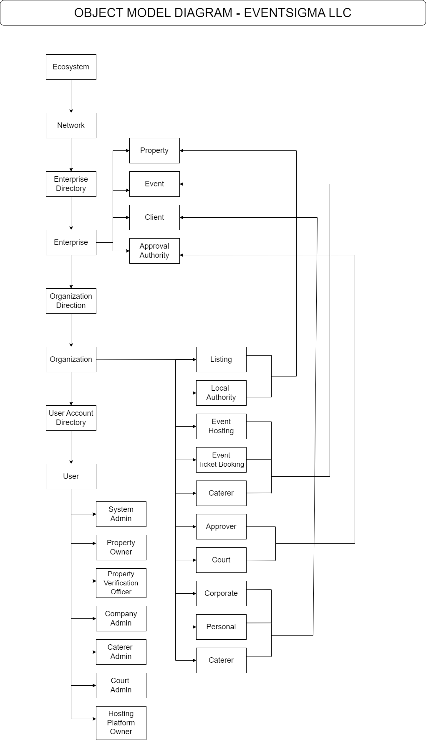
Object Model Diagram

Slide 4
Entities/Enterprises
Event Sigma LLC Event Management System has:
Property - Property Owner, Property Approver
Court - Court Admin
Event - Events near me, Book event tickets
Client - Corporate, Personal
Caterer - Caterer Admin, Caterers, Create food menu, Create food package
Reporting Module - Analytics and Business Intelligence

Slide 5
Workflow
Property
Property Owner - Create/Add Property by entering details (CRUD)
Property photos are uploaded
Property Approver - Assign other approvers
Physically visits the property for verification
Authenticity of details is verified, and property is either approved or rejected
Once the property is approved, it is ready to host an event
Client
Option of shortlisting the enlisted properties
Appropriate property is selected
Client adds event details
A file with property and event details is created
File is then sent to the Court for approval

Slide 6
Workflow
Court
Property and event details file is scrutinized
Court Approver - File is either approved or rejected for hosting the suitable event
Once accepted, the client (end user) can view event status
Host
End user can view available tickets for the selected event
Host can add caterer
Host adds appropriate food packages according to the requirements
Event
End user is someone who wants to attend the event
Events near me - search by city or event type
Book event tickets - User can view and register for the event
Users gets booking confirmation email by entering First Name and Email ID

Slide 7
Workflow
Caterer
Caterer Admin can add other caterers
Caterer Admin can perform CRUD operations
Caterers can create and curate food menu for specific events
Caterers can create food packages specific to the event
Food packages vary in content and price
Analytics and Business Intelligence
Analyst would be responsible for data analysis and reporting of the enterprises
Queries have been formulated to produce ad-hoc reports based on real-time data
Module has potential of becoming a full-fledged business unit

Slide 8
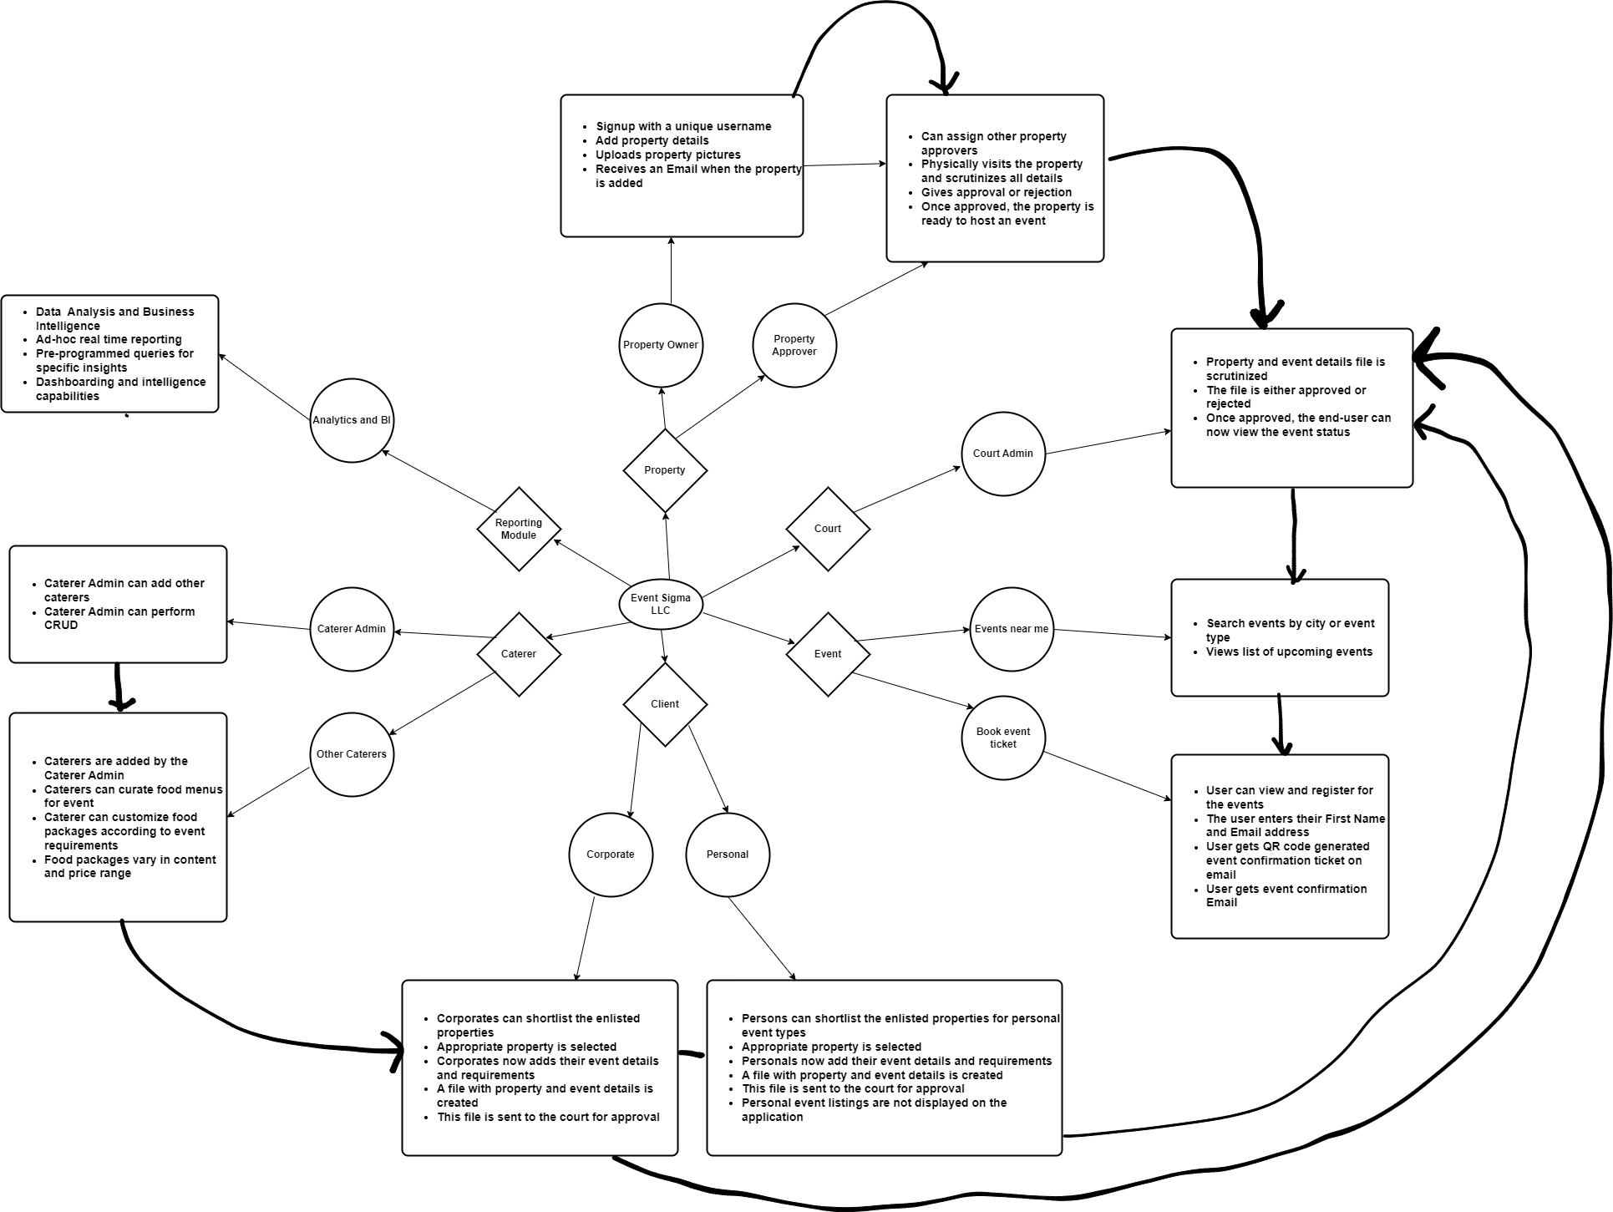
Workflow Diagram

Slide 9
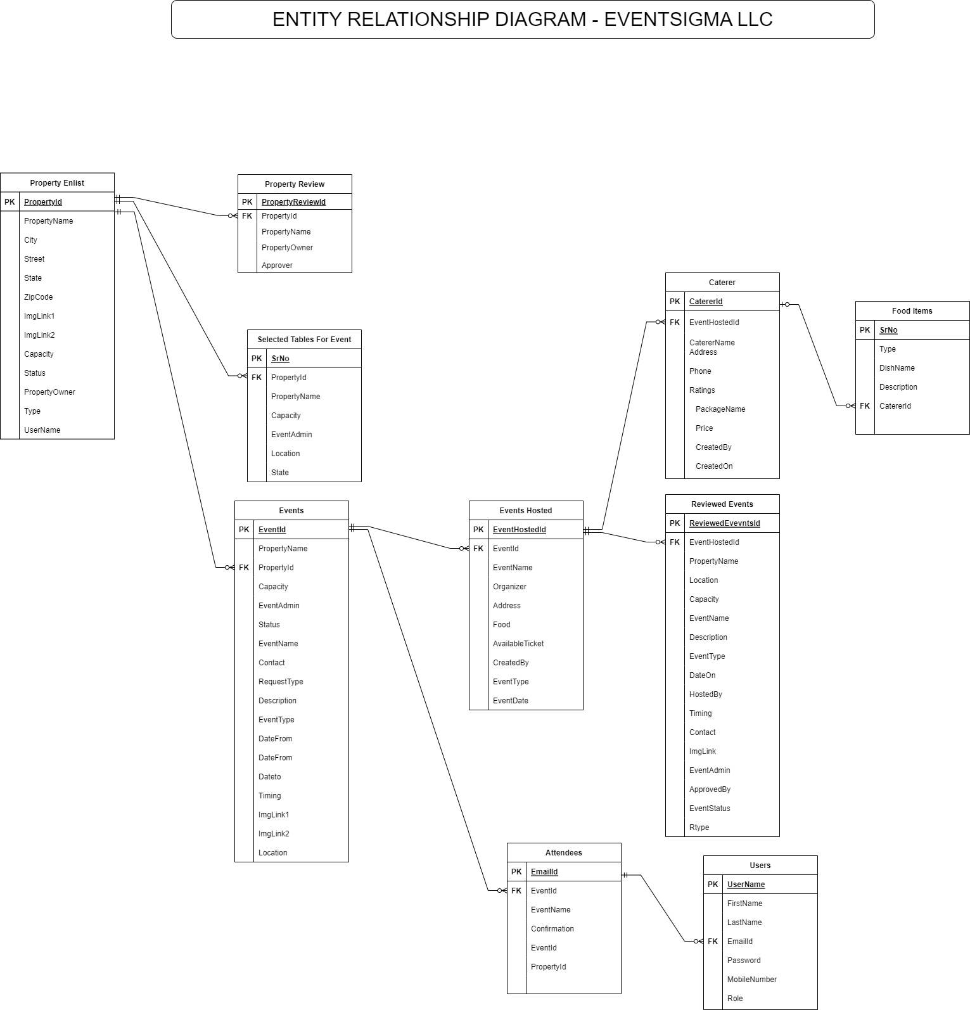
Entity Relationship Diagram

Slide 10
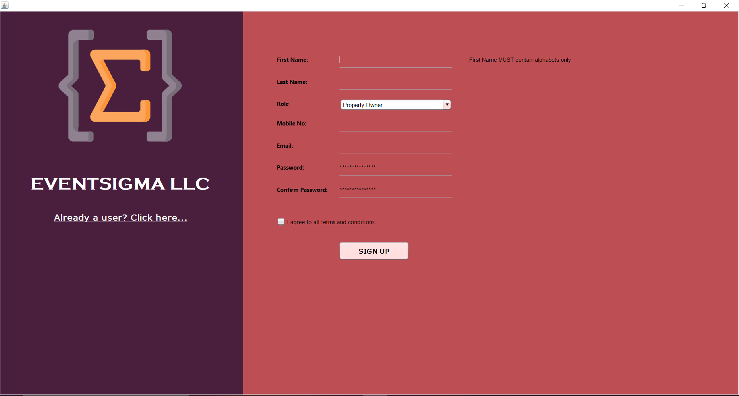
SignUp Now!
Thank You

